Slide 1
Mini project on
“Home automation system”
Under guidance : p. c. dhanawade.
Student names : Prathamesh Prakash kothawale [19uet017]
sanat bapurao Kulkarni [19uet018]
girish sunil gelani [19uet012]

Slide 2
outline
What is Raspberry pi and Home Automation?
Components used
System Diagram and working
Advantages and future scope

Slide 3
WHAT IS RASPBERRY PI ?
Low cost, high performance microcontroller
Has its own RAM,USB ports, HDMI ports and micro SD card slot
Can be used to develop a variety of projects like Home Automation
Available in version 1,2 and 3

Slide 4
WHAT IS HOME AUTOMATION ?
Controlling and managing electronic devices through mobile phones or laptops
Belongs to IOT
Involves Networking, ectronics and Programming
Make Life Easier

Slide 5
COMPONENTS USED
Raspberry pi 3 model B Microcontroller
Relay
PCB(Printed Circuit Board)
Network cables and other Connect cables

Slide 6
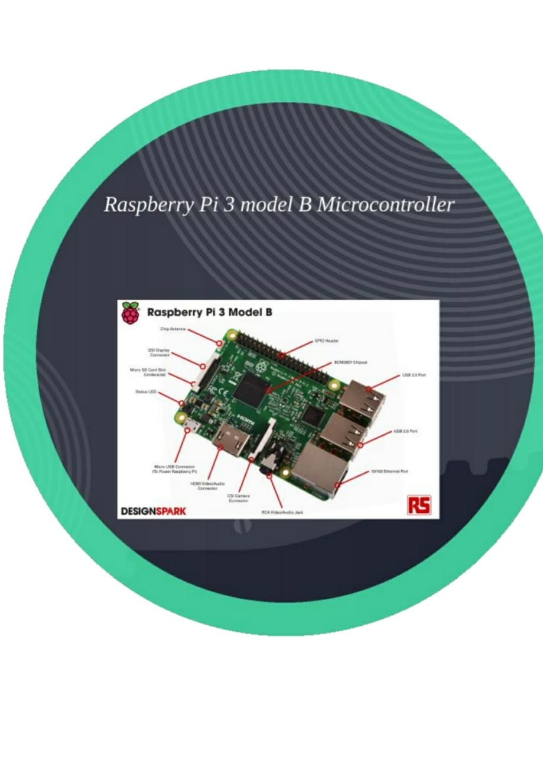
Raspberry pi 3 model b microcontroller

Slide 7
COMPONENTS USED
Raspberry pi
Relay module
Smart phone with app
A bulb

Slide 8
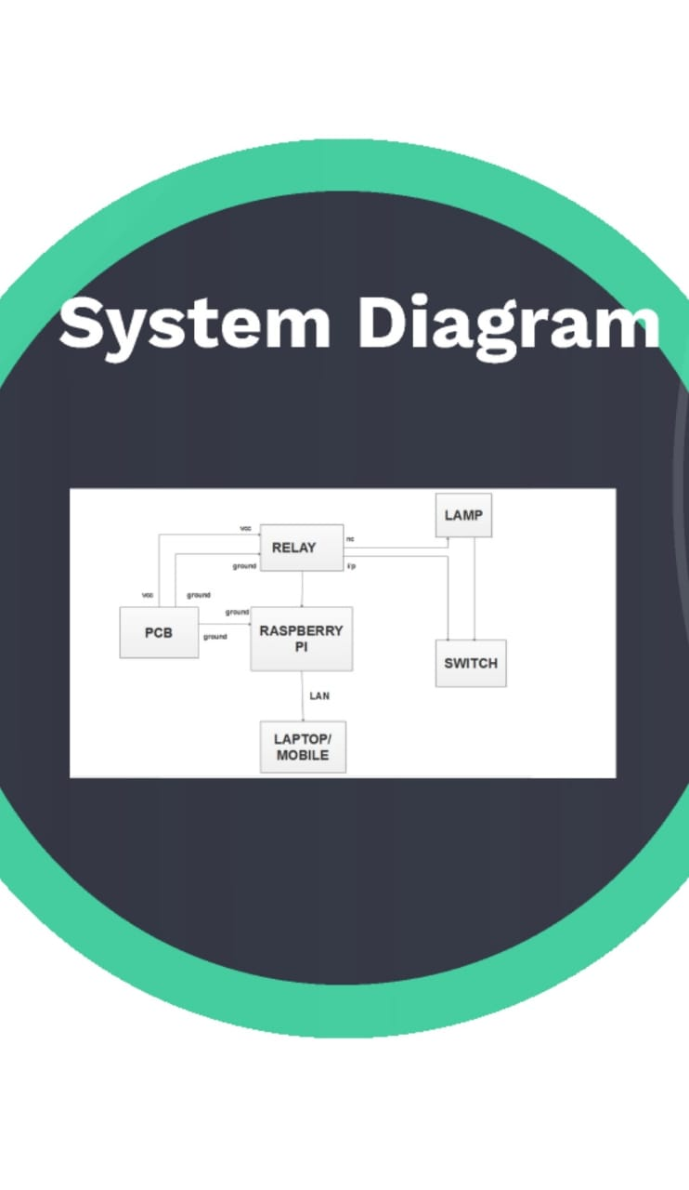
SYSTEM DIAGRAM

Slide 9
ADVANTAGES AND FUTURE SCOPES
Simpler and Easier life
Addition of Sensors and Solenoid Valves
More security and making it live

Slide 10
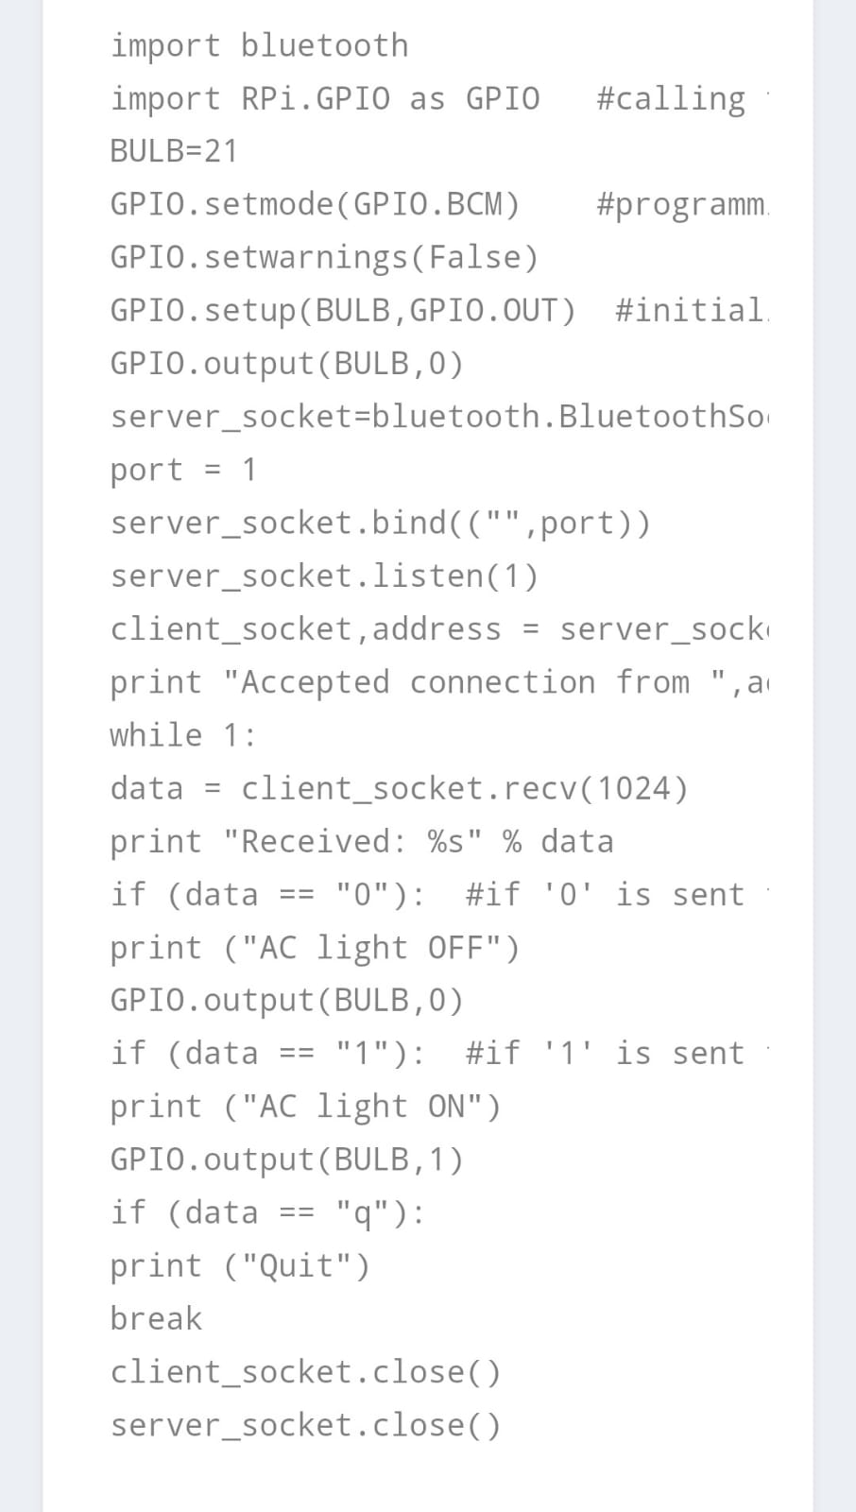
code

